Slide 1


NCKU Mechanical Engineering
3+1+1 Integrated Master’s Programme
The 3+1+1 Integrated Master’s Programme has been carefully matched to NCKU Mechanical Engineering UG course to ensure compatibility. It provides the opportunity for NCKU Mechanical Engineering students to diversify their knowledge and expertise towards electronics through international study experience in Southampton.
During your UG study abroad year you will:
  Choose a number of stimulating course modules according to your interests. (see the QR code link)
  Undertake a final year project at Southampton, making use of state of the art teaching facilities
NCKU Integrated Master’s Students Pathway
1st to 3rd Year - UG [@ NCKU] - Home University UG Course
  4th Year-UG [@ Southampton] - UG Study Abroad Year
  5th Year-MSc [@ Southampton] - 1 Master’s Degree Year
1st year
@ NCKU
2nd year
@ NCKU
3rd year
@ NCKU
1 study abroad year @ Soton
1 Master’s Degree year @ Soton

Slide 2
成功大學機械工程學系-南安普敦大學電子與資訊科學系
雙聯學位計畫
本計畫為成功大學學士-英國南安普敦大學碩士之3+1+1雙聯學位。透過至英國南安普敦電子與資訊科學系就讀，提供成大機械系學生發展電子工程領域專長並獲得相關學位的機會。
雙聯學位學程規劃
大學一年級至三年級：於成功大學就讀 (3)
大學四年級：於南安普敦大學就讀，取得成功大學學士學位 (1)
碩士一年級：於南安普敦大學就讀，取得南安普敦大學碩士學位 (1)
大學四年級至南安普敦電子與資訊科學系就讀的期間您將會:
  選擇有興趣的課程模組 (詳見QR code)
  在先進的學習環境中完成專題計畫
大學一年級
@成功大學
大學二年級
@成功大學
大學三年級
@成功大學
大學四年級
@南安普敦大學
碩士一年級
@南安普敦大學

Slide 3
Application Deadline And Semester Dates
NCKU 3+1+1 Integrated Master’s Programme 2021/2022
Application deadline | Open: 1 March Deadline: 15 May | Interested students should submit their completed applications to the NCKU Mechanical Engineering main office towards the end of their third year and before the deadline. Applications will be reviewed by the Mechanical Engineering Academic Committee, who will refer qualified students to the University of Southampton Admissions Team. Students will then make an application to the University of Southampton.
Teaching Period | Begin: Early October, 2021 End: End of March, 2022 | Term Dates
English Language Entry Requirement | UG: Band B 6.5 overall, 5.5 in each component PG: Band C 6.5 overall, 6.0 in each component | You will need to demonstrate that you have sufficient knowledge of the English language in order to be able to benefit from all academic activities at the University. Entry requirements are reviewed annually and may be subject to change. Tests that meet the acceptable standard
Tuition Fees | With the discount applied fees for the undergraduate year are £19,422 and for the postgraduate year £22,905. | Tuition fees for international students participating in this scheme are discounted by 10 per cent from standard rates

Slide 4
申請日期及學期期程
2021/2022 雙聯學位計畫
申請日期 | 3月1日- 5月15日 | 對此學程有興趣的學生，需在大三下學期提交完整的申請文件至成大機械系辦公室。 相關申請將先由成大機械系學委會審查後，推薦符合資格的學生向南安普敦大學提出申請入學相關文件。
學期期間 | 學期開始: 2021 10月上旬 學期結束: 2022 3月下旬
英文門檻 | 大學部: 英語能力等級 B (IELTS總分6.5, 每分項需達5.5) 研究所: 英語能力等級 C (IELTS總分6.5,每分項需達6.0) | 需證明有足夠英語能力，以有效學習及參與相關學術活動。 入學英文門檻每年會重新審定，標準可能變動。
學費 | 減免後的學費: 大學部-£19,422/年 研究所-£22,905/年 | 申請此學程的學生享有9折的學費減免。

Slide 5
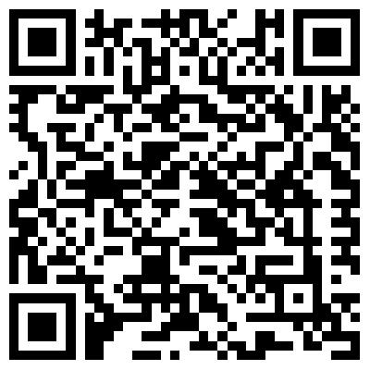
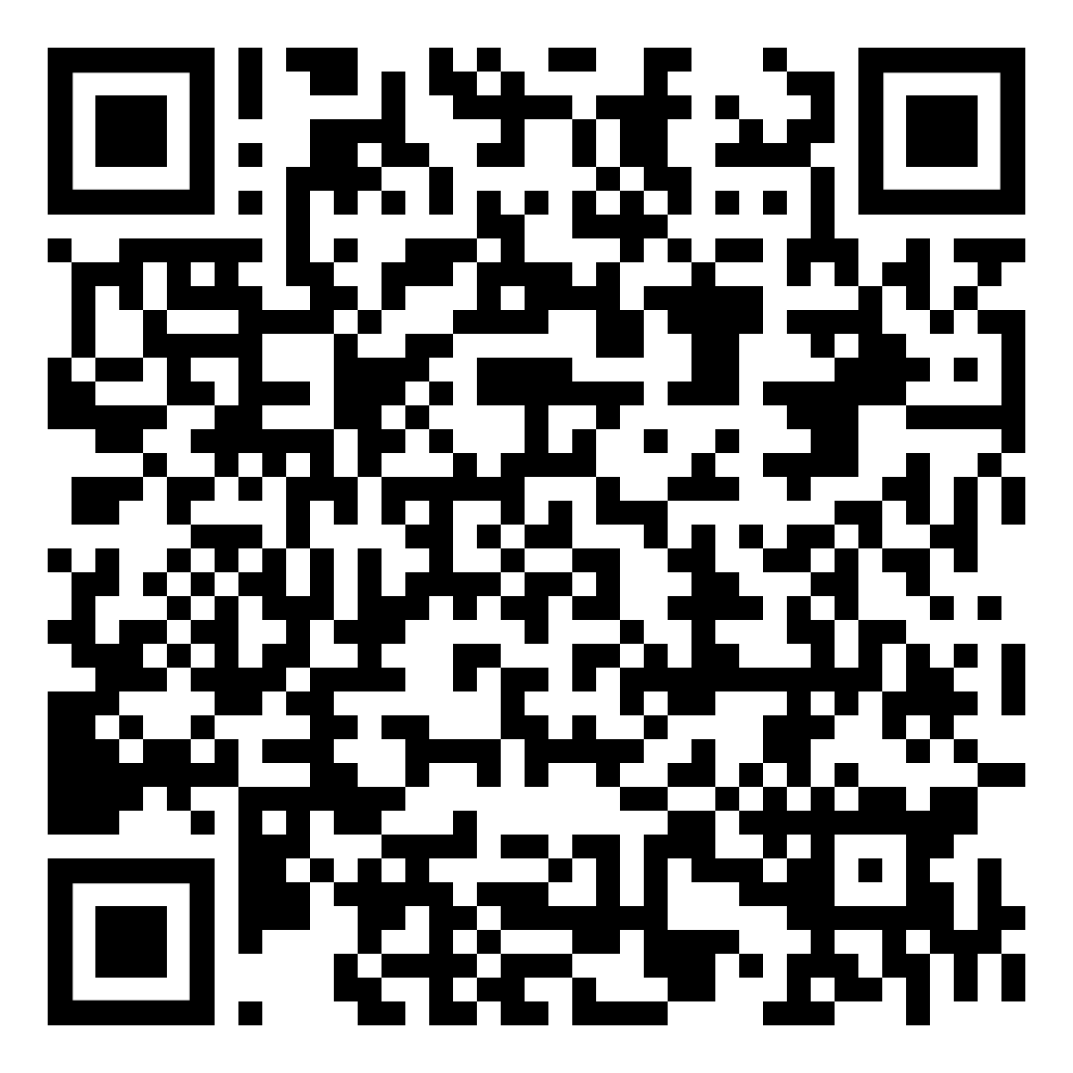
QR code links:
Electronic Engineering Courses for 4th UG year in University of Southampton | Electronic Engineering Course Modules for 1 PG year in University of Southampton

Slide 6
QR code 連結:
南安普敦大學電子工程 學士班課程模組 | 南安普敦大學電子工程 碩士班課程模組

Slide 7
Contact us:
National Cheng Kung University Mechanical Engineering Department Miss Cindy Tseng Email: cindy@mail.ncku.edu.tw Tel: +886 6 2757575 #62159 #65 NCKU International Office Miss Melody Tseng Email: tseng@gs.ncku.edu.tw Tel: +886 6 2757575 #50965 | University of Southampton International Study Abroad/ Exchange Scheme (for administrators at NCKU) Abbie Skinner Telephone: +44 (0)23 8059 7096 Email: studyabroad@soton.ac.uk
Found out more: www.southampton.ac.uk/tc/studyabroad

Slide 8
聯絡我們:
國立成功大學機械工程學系 曾馨儀小姐 Email: cindy@mail.ncku.edu.tw 電話: +886 6 2757575 #62159 #65 國際事務處 曾慧容專案經理 Email: tseng@gs.ncku.edu.tw 電話: +886 6 2757575 #50965 | 南安普敦大學 海外留學與交換計畫行政聯絡窗口 Abbie Skinner 電話: +44 (0)23 8059 7096 Email: studyabroad@soton.ac.uk
了解更多: www.southampton.ac.uk/tc/studyabroad

